Slide 1
Storyboard
Scenario-Based Coaching
Module Details:
Course Name: | Coaching, Providing Feedback & Recognition
Module Title: | Coaching Recap
Learning Format: | eLearning - Storyline
Audience: | Frontline Managers & Leaders
Challenge: | Use blended methods to reinforce learning transfer and extend learning beyond traditional ILT
Objectives: | Effectively manage with coaching. Apply your skills to ask effective questions. Assess your own skills and develop a coaching plan.
Time: | ~5 minutes

Slide 2
Module Details:
Course Name: | Coaching, Providing Feedback & Recognition
Module Title: | Coaching Recap
Slide Title: | Intro Slide
Animation: | Entrance from top
Navigation Notes: | User Controlled Menu Next
Visual:
Narration/Script:
Notes:
Clean Version

Slide 3
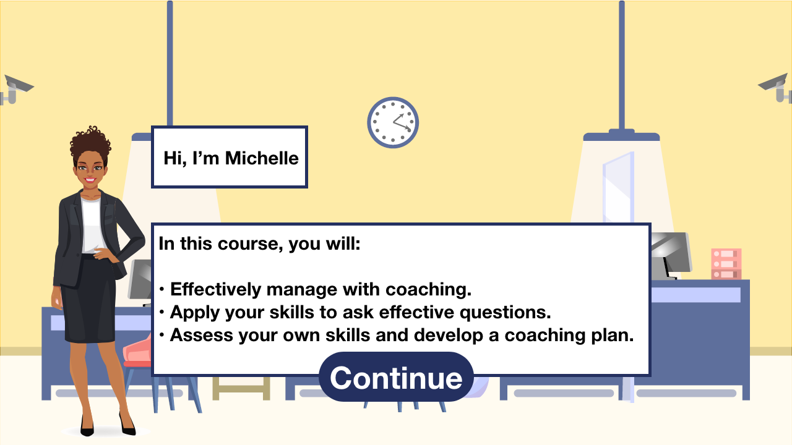
Module Details:
Course Name: | Coaching, Providing Feedback & Recognition
Module Title: | Coaching Recap
Slide Title: | Objectives
Animation: | Character swoosh in from right Objectives Entrance after voiceover
Navigation Notes: | User Controlled Menu Prev – Next
Visual:
Narration/Script:
(Voiceover) Hi, I’m Michelle, your mentor for your new leadership position. As managers, one of our roles is to coach employees to achieve business goals. (Text) In this course, you will: Identify the employee’s coaching needs with 90% accuracy as reported on the coaching scorecard. (Understanding) Given the employee’s needs, implement the GROW coaching model 9/10 times. (Analysis, Application) Create a coaching plan that best fits the employee’s needs to maintain consistent monthly coaching. (Synthesis).
Notes:
Clean Version

Slide 4
Module Details:
Course Name: | Coaching, Providing Feedback & Recognition
Module Title: | Coaching Recap
Slide Title: | Coaching Review
Animation: | Entrance from top after Voiceover
Navigation Notes: | User Controlled Menu Prev – Next
Visual:
Narration/Script:
(Voiceover) Remember, coaching is a continuous process that provides team members with support and encouragement. You want to raise employee awareness and facilitate growth to maximize performance. Coaching is a critical leadership tool because it: (Bulleted Text) affects performance, helps achieve goals, promotes teamwork, establishes open communication, teaches problem solving skills, and increases employee retention.
Notes:
Clean Version

Slide 5
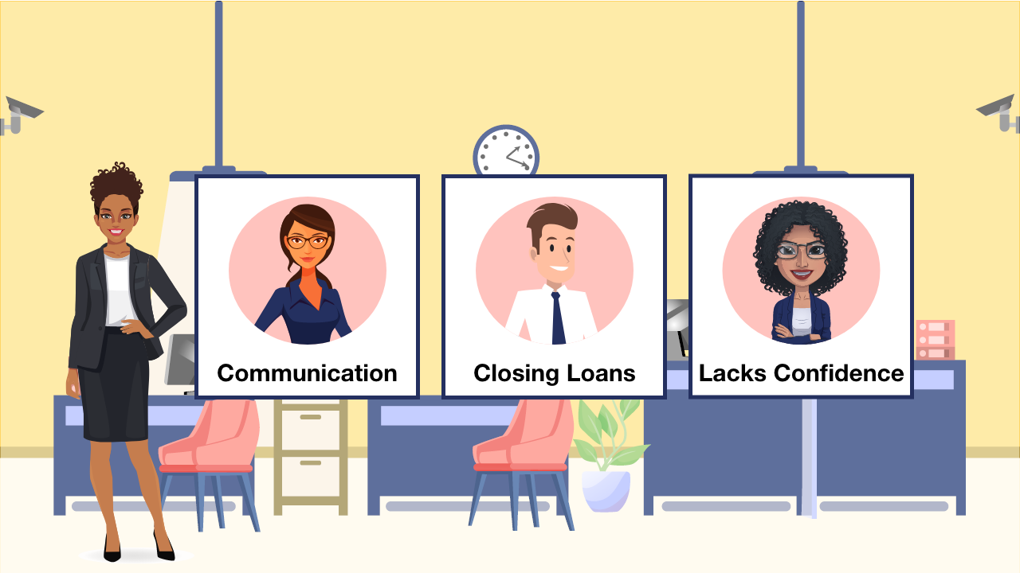
Module Details:
Course Name: | Coaching, Providing Feedback & Recognition
Module Title: | Coaching Recap
Slide Title: | Scenario Intro
Animation: | Entrance after voiceover. Flip cards to read more about employees
Navigation Notes: | User Controlled Menu Prev – Next
Visual:
Narration/Script:
(Voiceover) We’re going to start with some planned coaching sessions so you can familiarize yourself with the process. Your 1st session is coming up soon. There are 2 employees you will coach next week. You are going to pick the session you would like to facilitate first and practice coaching them here.
Notes:
Clean Version

Slide 6
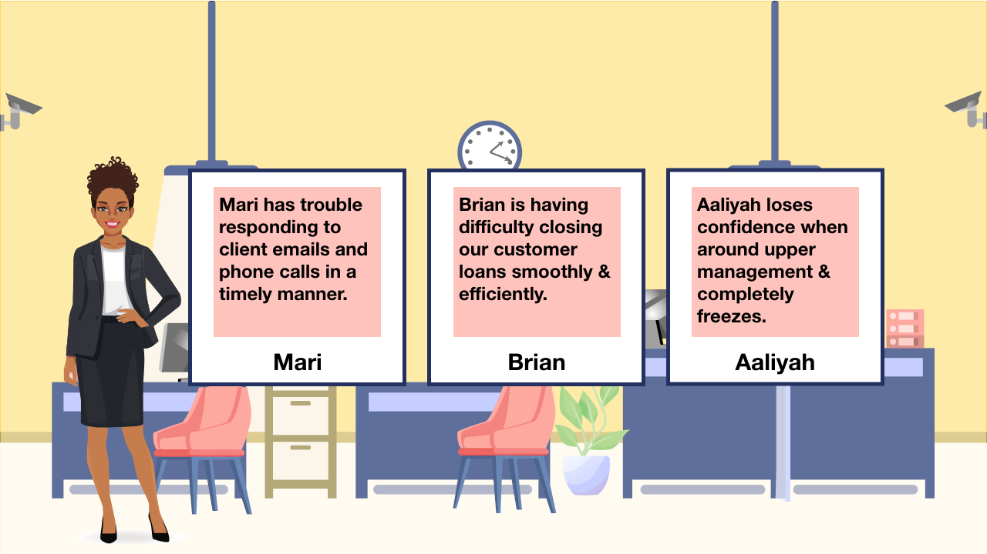
Module Details:
Course Name: | Coaching, Providing Feedback & Recognition
Module Title: | Coaching Recap
Slide Title: | Character Options
Animation: | Click on each person & it flips to give a little more detail. Include select button for user.
Navigation Notes: | User Controlled Menu Prev – Next
Visual:
Narration/Script:
Brian: Loan Closing Brian is having difficulty closing our customer loans smoothly & efficiently. Mari: Communication Mari has trouble responding to client emails and phone calls in a timely manner. Aaliyah: Lacking Confidence Aaliyah lacks confidence when around upper management and completely freezes.
Notes:
Clean Version

Slide 7
Module Details:
Course Name: | Coaching, Providing Feedback & Recognition
Module Title: | Coaching Recap
Slide Title: | Scenario Greetings
Animation:
Navigation Notes: | User Controlled Menu Prev – Next
Visual:
Narration/Script:
(Voiceover) Excellent you picked Brian! His coaching session is Wednesday at 1pm. Let’s plan for what might occur during your meeting. Brian comes into your office and greetings are made. For the sake of this scenario, we are going to move straight past the small talk and dig right into the coaching portion of the conversation. Don’t forget to use the GROW coaching model when meeting with Brian. Always start with the goal, discuss current reality, consider options, and review the way forward. Good luck with your session. I will be here each step of the way providing you with feedback.
Notes:
Clean Version

Slide 8
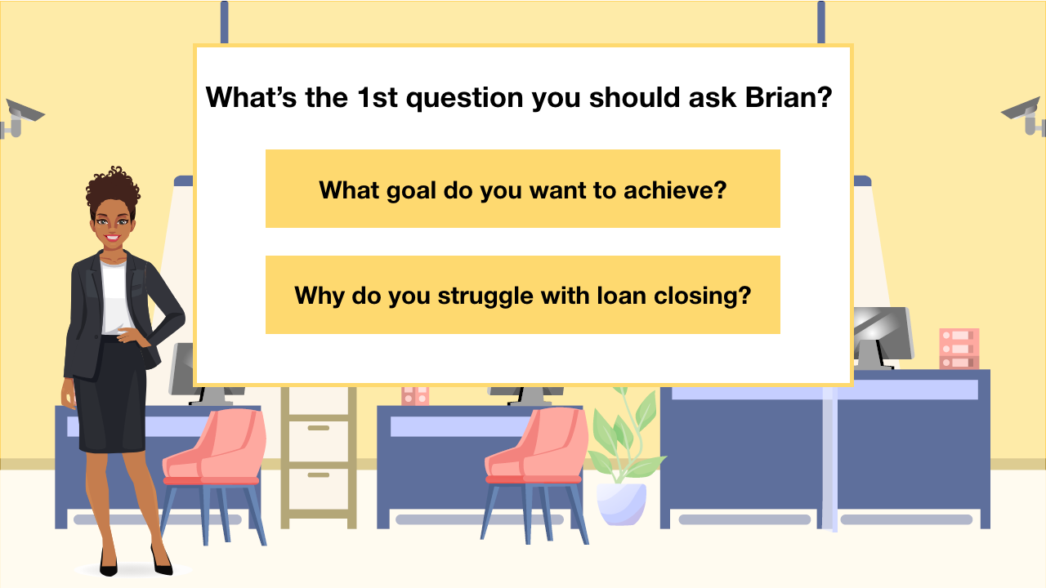
Module Details:
Course Name: | Coaching, Providing Feedback & Recognition
Module Title: | Coaching Recap
Slide Title: | Coaching Question 1
Animation: | User selects question w/hover color
Navigation Notes: | User Controlled Menu Prev – Next
Visual:
Narration/Script:
What’s the 1st coaching question you should ask Brian? What goal do you want to achieve? Great question! This opens the door and lets Brian know that you believe in him while letting him take ownership of their goal. Why do you struggle with loan closing? Brian believes he is hard-working and feels attacked by this question. He begins to shut down.
Notes:
Clean Version

Slide 9
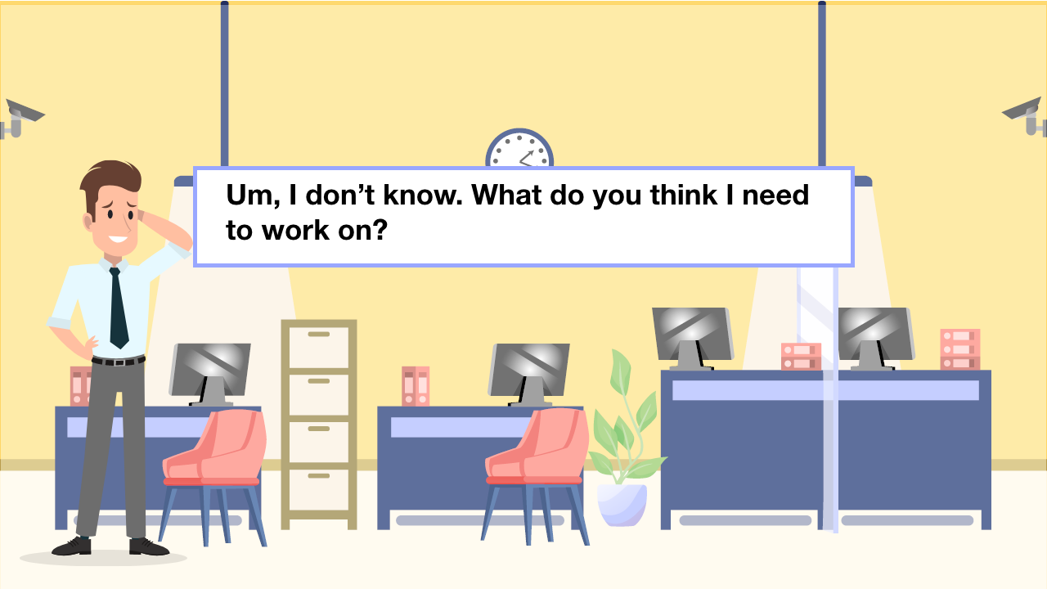
Module Details:
Course Name: | Coaching, Providing Feedback & Recognition
Module Title: | Coaching Recap
Slide Title: | Incorrect Response
Animation: | Continue button hover
Navigation Notes: | User Controlled Menu Prev – Next
Visual:
Narration/Script:
Response: (Hesitant to open up) Um, I don’t know. What do you think I need to work on?
Notes:
Clean Version

Slide 10
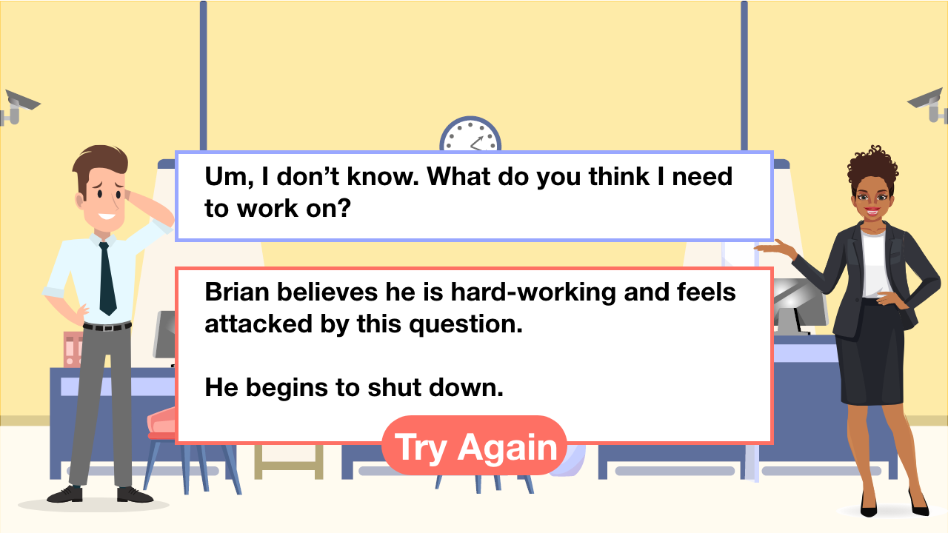
Module Details:
Course Name: | Coaching, Providing Feedback & Recognition
Module Title: | Coaching Recap
Slide Title: | Incorrect Feedback
Animation: | Button hover
Navigation Notes: | User Controlled Menu Prev – Next Try again back to question
Visual:
Narration/Script:
Narrator Feedback: Brian believes he is hard-working and feels attacked by this question. He begins to shut.
Notes:
Clean Version

Slide 11
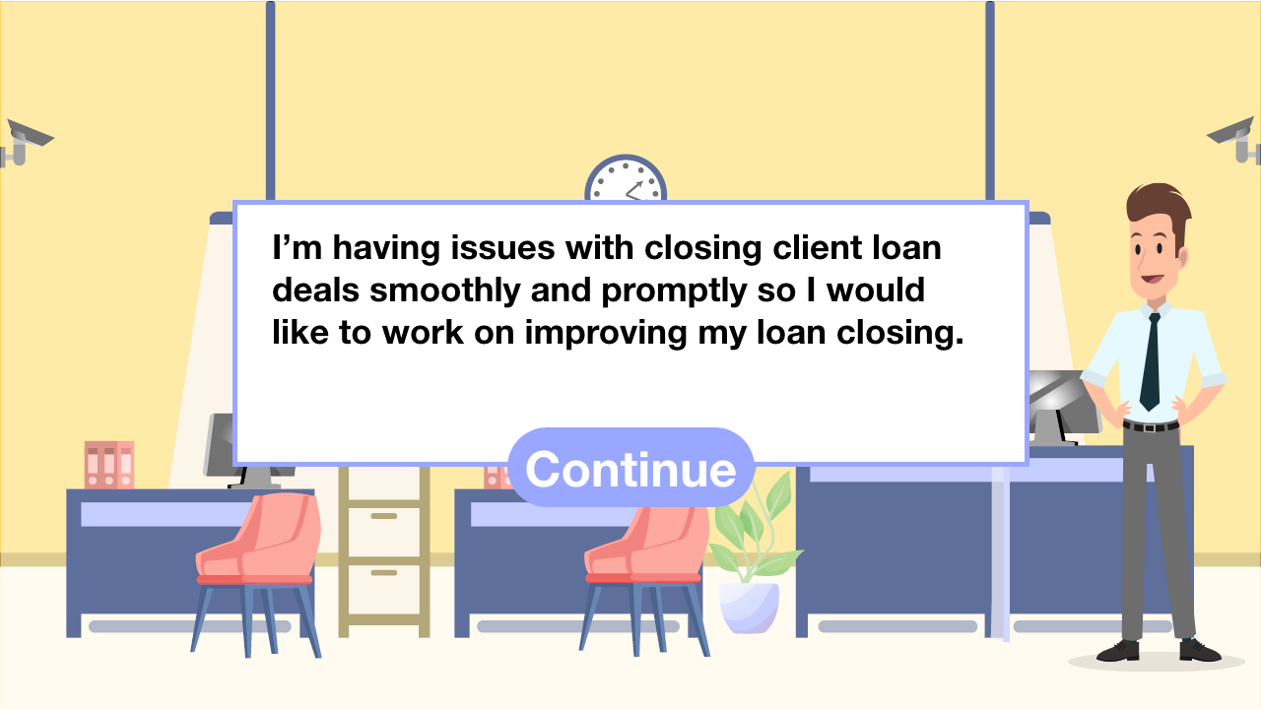
Module Details:
Course Name: | Coaching, Providing Feedback & Recognition
Module Title: | Coaching Recap
Slide Title: | Correct Response
Animation: | Button hover
Navigation Notes: | User Controlled Menu Prev – Next
Visual:
Narration/Script:
Response: I’m having issues with closing client loan deals smoothly and promptly so I would like to work on improving my loan closing.
Notes:
Clean Version

Slide 12
Module Details:
Course Name: | Coaching, Providing Feedback & Recognition
Module Title: | Coaching Recap
Slide Title: | Correct Feedback
Animation: | Button hover
Navigation Notes: | User Controlled Menu Prev – Next
Visual:
Narration/Script:
Narrator Feedback: Great question! This opens the door and lets Brian know that you believe in him while letting him take ownership of his goal.
Notes:
Clean Version

Slide 13
Module Details:
Course Name: | Coaching, Providing Feedback & Recognition
Module Title: | Coaching Recap
Slide Title: | Coaching Question 2
Animation: | question hover color
Navigation Notes: | User Controlled Menu Prev – Next
Visual:
*Same layout as 1st question
Narration/Script:
You respond by repeating Brian’s goal so he knows you are listening. What should you ask next? I’m hearing your difficulty with loan closing. What progress have you made so far? This question helps Brian gain awareness of the current situation – what’s going on, the context, and scale. I’m hearing your difficulty with loan closing. If you don’t have a plan, how will you get it done? This is a rhetorical question and assumes Brian doesn’t have a plan. Brian is feeling defeated by this meeting and wants to give up everything he’s tried.
Notes:
Clean Version

Slide 14
Module Details:
Course Name: | Coaching, Providing Feedback & Recognition
Module Title: | Coaching Recap
Slide Title: | Response 2
Animation: | Button hover
Navigation Notes: | User Controlled Menu Prev – Next
Visual:
Same correct response layout
Narration/Script:
Response: I am currently working on a loan closing to-do list and managing my time.
Notes:
Clean Version

Slide 15
Module Details:
Course Name: | Coaching, Providing Feedback & Recognition
Module Title: | Coaching Recap
Slide Title: | Coaching Question 3
Animation: | Question hover color
Navigation Notes: | User Controlled Menu Prev – Next
Visual:
Same as 1st question layout
Narration/Script:
What should you ask Brian next to help him explore options and generate solutions? What has contributed to your success so far? Great question, Brian clearly understands the situation and this question allows him to generate solutions to reach his goal. Have you tried ___? This doesn’t allow for Brian to come up with possible solutions. These are the solutions that may work for you, but not Brian.
Notes:
Clean Version

Slide 16
Module Details:
Course Name: | Coaching, Providing Feedback & Recognition
Module Title: | Coaching Recap
Slide Title: | Response 3
Animation: | Button hover color
Navigation Notes: | User Controlled Menu Prev – Next
Visual:
Correct response lauout
Narration/Script:
Response: Collaborating with peers on their success with loan closings and researching loan closing lists that I could possibly use to help with the process.
Notes:
Clean Version

Slide 17
Module Details:
Course Name: | Coaching, Providing Feedback & Recognition
Module Title: | Coaching Recap
Slide Title: | Coaching Question 4
Animation: | Question hover color
Navigation Notes: | User Controlled Menu Prev – Next
Visual:
Same layout as 1st question
Narration/Script:
Now that Brian has explored solutions, what could you ask to probe for and achieve commitment? What else could you do? Good question to measure Brian’s level of commitment. This helps Brian establish a clear action plan for next steps. Have you thought about asking me? Yes or no questions are not effective in coaching. You want to develop trust with Brian so he will ask for your help openly moving forward.
Notes:
Clean Version

Slide 18
Module Details:
Course Name: | Coaching, Providing Feedback & Recognition
Module Title: | Coaching Recap
Slide Title: | Response 4
Animation: | Button hover color
Navigation Notes: | User Controlled Menu Prev – Next
Visual:
Correct response layout
Narration/Script:
Response: I’d like to discuss the list with you and start using a calendar for each loan client with due dates for closing documents.
Notes:
Clean Version

Slide 19
Module Details:
Course Name: | Coaching, Providing Feedback & Recognition
Module Title: | Coaching Recap
Slide Title: | Closing
Animation: | Button hover color
Navigation Notes: | User Controlled Menu Prev – Next
Visual:
Same layout as narrator above
Narration/Script:
Closing: Ok, let’s talk next Wednesday at 1:00 to discuss action steps and what your success would look like. I’d be happy to look over the loan closing to-do list at that time too. Is that realistic?
Notes:
Clean Version

Slide 20
Module Details:
Course Name: | Coaching, Providing Feedback & Recognition
Module Title: | Coaching Recap
Slide Title: | Response 5
Animation: | Button hover color
Navigation Notes: | User Controlled Menu Prev – Next
Visual:
Character slide layout
Narration/Script:
Yes, thank you for meeting with me.
Notes:
Clean Version

Slide 21
Module Details:
Course Name: | Coaching, Providing Feedback & Recognition
Module Title: | Coaching Recap
Slide Title: | Scenario Greetings
Animation: | Button hover color
Navigation Notes: | User Controlled Menu Prev – Next
Visual:
Narration/Script:
(Voiceover) Excellent choice! Hana’s coaching session is Friday at 11am. Let’s plan for what might occur during your meeting. Hana comes into your office and greetings are made. For the sake of this scenario, we are going to move straight past the small talk and dig right into the coaching portion of the conversation. Don’t forget to use the GROW coaching model when meeting with Hana. Always start with the goal, discuss current reality, consider options, and review the way forward. Good luck with your session. I will be here each step of the way providing you with feedback.
Notes:
Clean Version

Slide 22
Module Details:
Course Name: | Coaching, Providing Feedback & Recognition
Module Title: | Coaching Recap
Slide Title: | Coaching Question 1
Animation: | Button hover color
Navigation Notes: | User Controlled Menu Prev – Next
Visual:
**Please note: format will be the same, but characters and text will represent the 2nd character (text below)
Narration/Script:
What’s the 1st coaching question you should ask Mari? What could we work on that would make a big difference at work? Do you have any problems with communication?
Notes:
Clean Version

Slide 23
Module Details:
Course Name: | Coaching, Providing Feedback & Recognition
Module Title: | Coaching Recap
Slide Title: | Incorrect Response
Animation: | Button hover color
Navigation Notes: | User Controlled Menu Prev – Next
Visual:
**Please note: format will be the same, but characters and text will represent the 2nd character (text below)
Narration/Script:
Response: (Hesitant to open up) Um, I don’t know. What communication issues have you observed from me?
Notes:
Clean Version

Slide 24
Module Details:
Course Name: | Coaching, Providing Feedback & Recognition
Module Title: | Coaching Recap
Slide Title: | Incorrect Feedback
Animation: | Button hover color
Navigation Notes: | User Controlled Menu Prev – Next
Visual:
**Please note: format will be the same, but characters and text will represent the 2nd character (text below)
Narration/Script:
Narrator Feedback: Mari feels pushed to go in the direction you want, this is a leading question. She feels disempowered. She begins to shut down.
Notes:
Clean Version

Slide 25
Module Details:
Course Name: | Coaching, Providing Feedback & Recognition
Module Title: | Coaching Recap
Slide Title: | Correct Response
Animation: | Button hover color
Navigation Notes: | User Controlled Menu Prev – Next
Visual:
**Please note: format will be the same, but characters and text will represent the 2nd character (text below)
Narration/Script:
Response: I’m struggling with responding to client emails and calls in a timely manner, there’s just too much to do in a day. I would like to work on responding to communication within 24-48 hours of receipt.
Notes:
Clean Version

Slide 26
Module Details:
Course Name: | Coaching, Providing Feedback & Recognition
Module Title: | Coaching Recap
Slide Title: | Correct Feedback
Animation: | Button hover color
Navigation Notes: | User Controlled Menu Prev – Next
Visual:
Narration/Script:
Narrator Feedback: Great question! This opens the door and lets Mari know that you believe in her while letting him take ownership of their goal.
Notes:
Clean Version

Slide 27
Module Details:
Course Name: | Coaching, Providing Feedback & Recognition
Module Title: | Coaching Recap
Slide Title: | Coaching Question 2
Animation: | Button hover color
Navigation Notes: | User Controlled Menu Prev – Next
Visual:
Same layout as previous character
Narration/Script:
You respond by repeating Mari’s goal so she knows you are listening. What should you ask next? I’m hearing your difficulty with communication. Where are you now in relation to your goal? This question helps Mari gain awareness of the current situation – what’s going on, the context, and scale. I’m hearing your difficulty with communication. Do you feel like you’ve made progress? Mari gives you a standard yes or no. This is a close-ended question and Mari doesn’t feel like you’re interested in inventing the time to help her. She’s ready to give up..
Notes:
Clean Version

Slide 28
Module Details:
Course Name: | Coaching, Providing Feedback & Recognition
Module Title: | Coaching Recap
Slide Title: | Response 2
Animation: | Button hover color
Navigation Notes: | User Controlled Menu Prev – Next
Visual:
Same layout as previous character
Narration/Script:
Response: I check my emails and voicemails daily, but I get sidetracked by other tasks on my list.
Notes:
Clean Version

Slide 29
Module Details:
Course Name: | Coaching, Providing Feedback & Recognition
Module Title: | Coaching Recap
Slide Title: | Coaching Question 3
Animation: | Button hover color
Navigation Notes: | User Controlled Menu Prev – Next
Visual:
Same layout as previous character
Narration/Script:
What should you ask Brian next to help him explore options and generate solutions? What do you think you need to do next? Great question, you are helping Mari to understand the extent of the situation and this question allows her to generate solutions to reach her goal. Why do you keep doing it then? You should always avoid rhetorical questions in a coaching conversation. Mari feels judged and is becoming uncomfortable. Mari should be encouraged to find solutions.
Notes:
Clean Version

Slide 30
Module Details:
Course Name: | Coaching, Providing Feedback & Recognition
Module Title: | Coaching Recap
Slide Title: | Response 3
Animation: | Button hover color
Navigation Notes: | User Controlled Menu Prev – Next
Visual:
Same layout as previous character
Narration/Script:
Response: I need to set time aside at the beginning and end of my day to respond to client communications as well as completing a daily task checklist.
Notes:
Clean Version

Slide 31
Module Details:
Course Name: | Coaching, Providing Feedback & Recognition
Module Title: | Coaching Recap
Slide Title: | Coaching Question 4
Animation: | Button hover color
Navigation Notes: | User Controlled Menu Prev – Next
Visual:
Same layout as previous character
Narration/Script:
Now that Mari has explored solutions, what could you ask to probe for and achieve commitment? Tell me, how are you going to do that? Good question to measure Mari’s level of commitment. This helps establish a clear action plan for next steps. Why isn’t it working? You are assuming that Mari’s solution is not working when it could be in small ways. You want to develop trust with Mari so she will ask for your help openly moving forward.
Notes:
Clean Version

Slide 32
Module Details:
Course Name: | Coaching, Providing Feedback & Recognition
Module Title: | Coaching Recap
Slide Title: | Response 4
Animation: | Button hover color
Navigation Notes: | User Controlled Menu Prev – Next
Visual:
Same layout as previous character
Narration/Script:
Response: I’d love to create a task list with your assistance and talk to your typical day so I can get ideas on how others are successful with their communications.
Notes:
Clean Version

Slide 33
Module Details:
Course Name: | Coaching, Providing Feedback & Recognition
Module Title: | Coaching Recap
Slide Title: | Closing
Animation: | Button hover color
Navigation Notes: | User Controlled Menu Prev – Next
Visual:
Same layout as previous character
Narration/Script:
Closing: Ok, let’s talk next Friday at 11:00 to discuss action steps and what your success would look like. I’d be happy to look over you plan, including challenges and successes, at that time. Is that realistic?
Notes:
Clean Version

Slide 34
Module Details:
Course Name: | Coaching, Providing Feedback & Recognition
Module Title: | Coaching Recap
Slide Title: | Response 5
Animation: | Button hover color
Navigation Notes: | User Controlled Menu Prev – Next
Visual:
Same layout as previous character
Narration/Script:
Yes, thank you for meeting with me.
Notes:
Clean Version

Slide 35
Module Details:
Course Name: | Coaching, Providing Feedback & Recognition
Module Title: | Coaching Recap
Slide Title: | Course Exit
Animation: | Button hover color
Navigation Notes: | User Controlled Menu Prev Exit Course
Visual:
Same layout as previous character
Narration/Script:
Great work on your 1st coaching session. Now think about what went well and how you might improve for your next session.
Notes:
Clean Version

